Slide 1
Level 4 Diploma in Dance Teaching
Unit 2 Technique and Syllabus Knowledge

Slide 2
Unit 2 structure
Similar to current Associate
Modular or whole exam format
Learners tested on knowledge of syllabus requirements for chosen genre
General discussion
Notes:
Unit 2 is very similar to the current Associate examination.
We have removed teaching requirements which now appear in Unit 3.
Learners can still do the unit in a modular or whole examination format but we have revised some of the timings to make the whole exam and modules in their entirely more comparable in terms of timing. There will be more time devoted to the modules as learners will require time in each module for aspects such as warm up which will only be done once in the whole exam format.

Slide 3
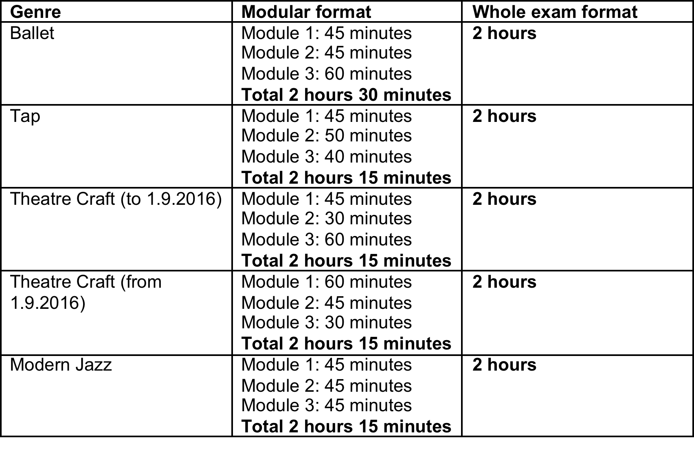
Unit 2 formats and timings
Notes:
Theatre genre – these are all very similar apart from Ballet which has a larger module 3 to allow for pointe work.

Slide 4
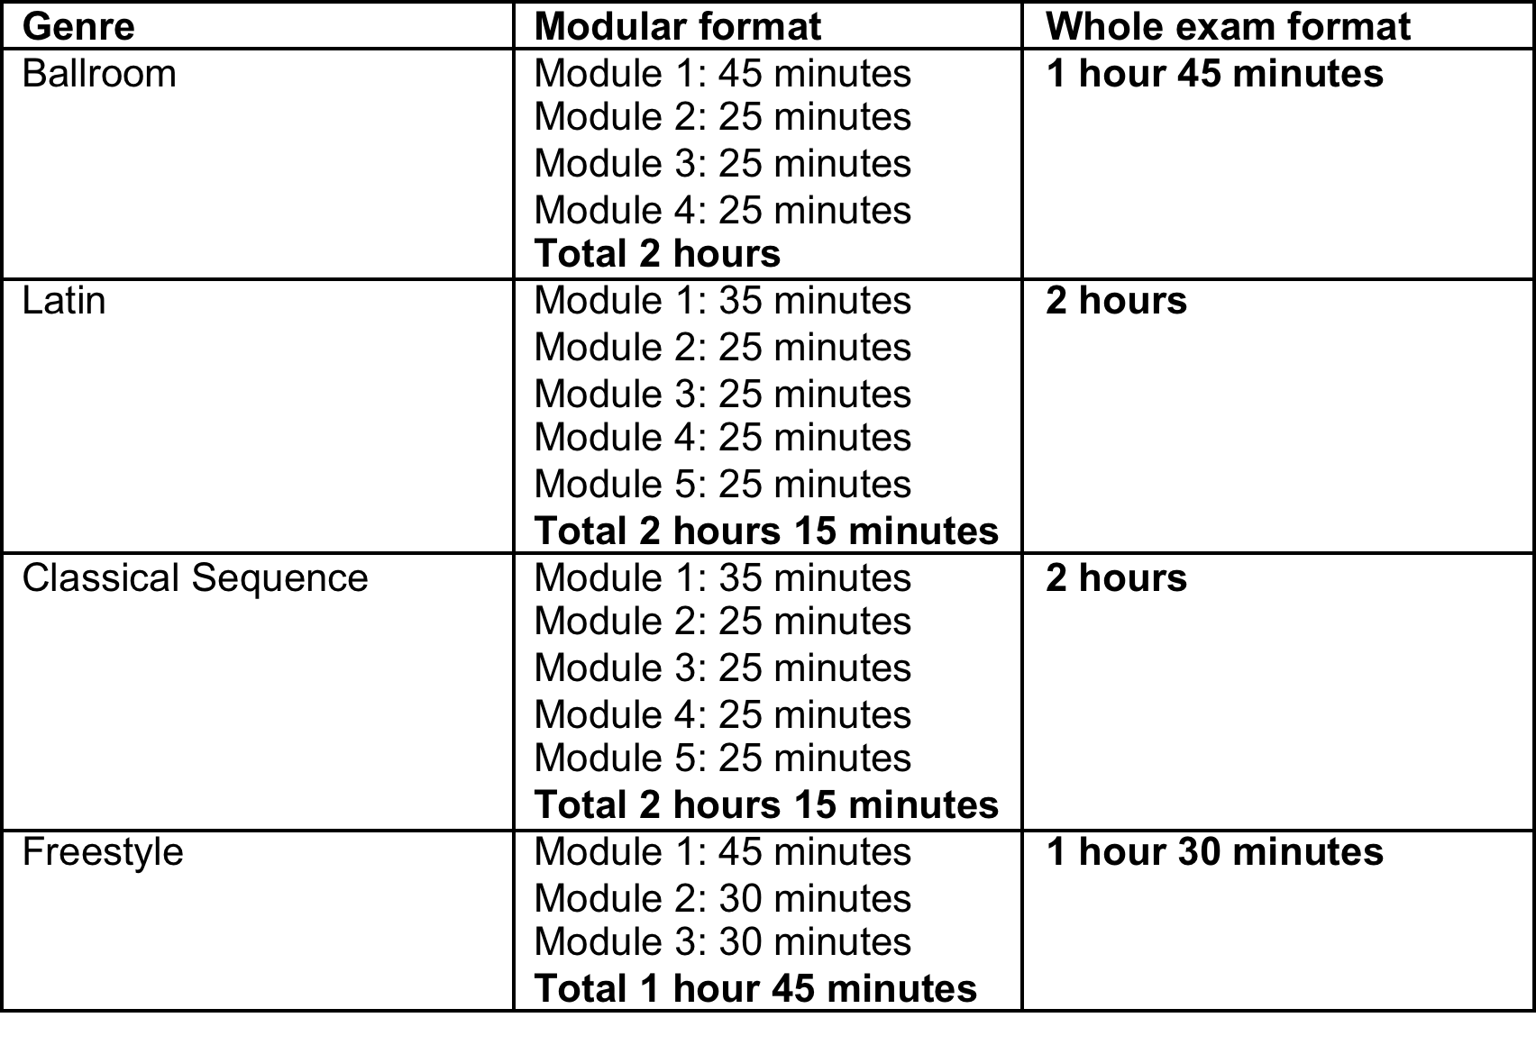
Unit 2 formats and timings
Notes:
Ballroom genres are all the same apart from Freestyle which has slightly different timings and less modules.

Slide 5
General discussion
Short discussion between the learner and examiner
Examples of topics include:
The history/development of the genre
Important or influential individuals, works or productions
Why you practice the genre and what you like about it
What made you start dancing and what has made you carry on with dancing
How dancing portrayed in the media has had an influence on you
Notes:
A general discussion has been added to Unit 2. This is so the learner can show their knowledge about their chosen genre and how it has influenced their own dancing. Learners may choose any subject to talk about within their genre – the slides give some examples of topics the learner may want to talk about.
The examiner and learner will have a short discussion about the chosen topic and genre, with the examiner looking for interest in and enthusiasm for the genre and the learner’s knowledge.
Questions from the examiner could include:
What made the learner take up dance or the genre
Who or what has had the biggest influence on them.
What they like most about the genre.
A performance they have watched
Individuals they enjoy watching dance

